Slide 1

Flight Price Prediction Project
Created By – Kshitij Chawla

Slide 2
Problem Statement
Anyone who has booked a flight ticket knows how unexpectedly the prices vary. The cheapest available ticket on a given flight gets more and less expensive over time. This usually happens as an attempt to maximize revenue based on -
1. Time of purchase patterns (making sure last-minute purchases are expensive)
2. Keeping the flight as full as they want it (raising prices on a flight which is filling up in order to reduce sales and hold back inventory for those expensive last-minute expensive purchases)
So, we have to work on a project where you collect data of flight fares with other features and work to make a model to predict fares of flights.

Slide 3
Conceptual Background of the Domain Problem
The project will require knowledge and practice in building Graphs /plots and analysing them to get the relationship between dataset, Knowledge of Different Learning Models to build and predict the required output. Basic Data science concepts to increase the quality of the dataset and Python Knowledge (Coding Language) which will be used to solve the complete Micro Credit Defaulter project. Understanding of calculating R2 Score, MSE, skewness and basic mathematics/statistical approaches will help to build an accurate model for this project.

Slide 4
Exploratory Data Analysis performed on the dataset
1) Checked the shape of the dataset : We have 1525 rows and 11 columns in our dataset
2) Checked the datatypes of the columns:
We have int, float and object type variable in dataset
3) There are no null values present in the dataset
5) Outliers are present in destination hours columns, We will be required to remove outliers before building the model
Outliers are checked using BoxPlot method available in python library

Slide 5
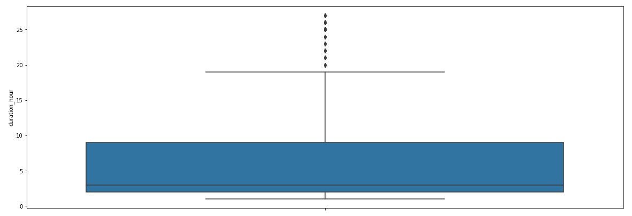
Exploratory Data Analysis performed on the dataset
Outliers Example from our dataset –

Slide 6
Exploratory Data Analysis performed on the dataset
6) Do airfares change frequently? Do they move in small increments or in large jumps? Do they tend to go up or down over time?
Answer-> The Airfares of the flight changes over time. Changes in Flight fare can be seen changed in large jumps over time. The Fares are tend to go down over the time as observed from below graph:

Slide 7
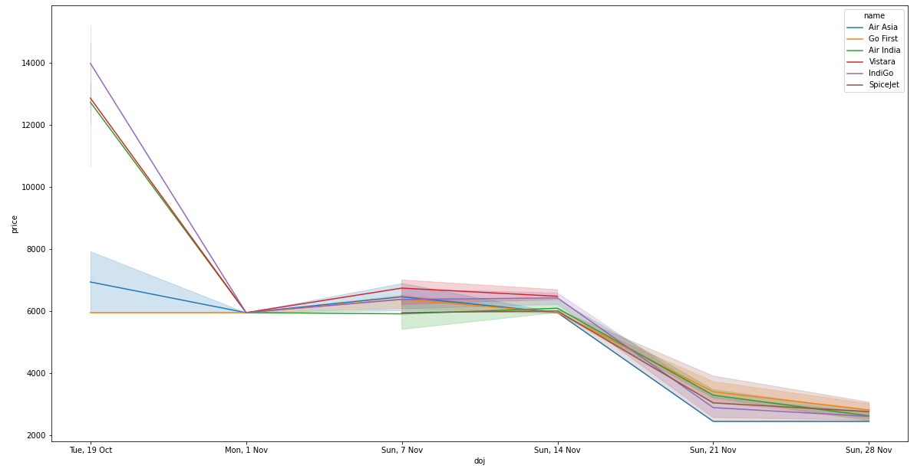
Exploratory Data Analysis performed on the dataset
Price Fair as per the different journey dates

Slide 8
Exploratory Data Analysis performed on the dataset
What is the best time to buy so that the consumer can save the most by taking the least risk?
Answer-> The best time to book a flight will be 1 month before the date of journey. Drastic difference in fares can be seen with increase in time frame of date of journey and day of booking. This can be observed in the graph present in the previous slide.

Slide 9
Exploratory Data Analysis performed on the dataset
Does price increase as we get near to departure date? Is Indigo cheaper than Jet Airways? Are morning flights expensive?
Answer -> The price for the flight increases as we get near the departure date. Indigo price fare can be observed to be cheaper. Morning Flights are cheaper as compared to flights going in afternoon or Night.

Slide 10
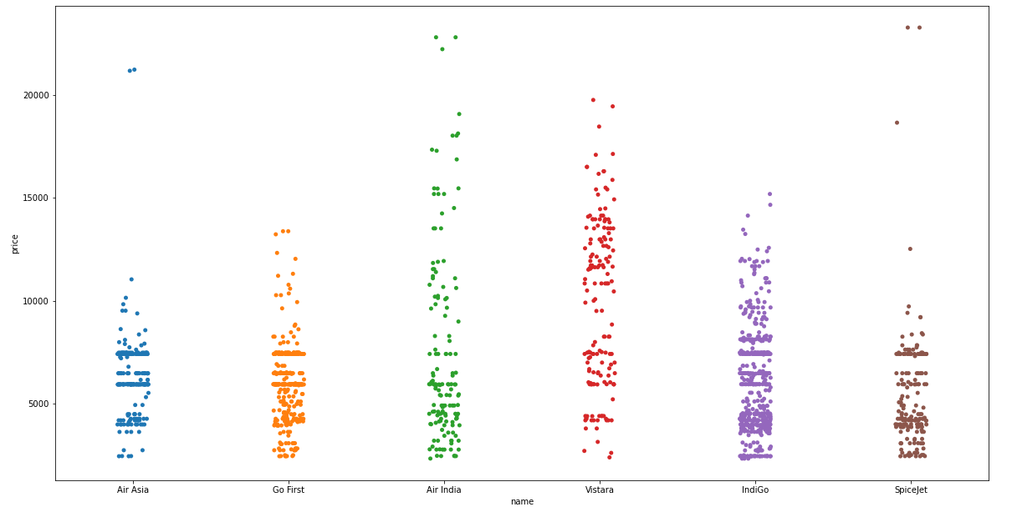
Exploratory Data Analysis performed on the dataset
Analysis Graph for Flight fare as per different company

Slide 11
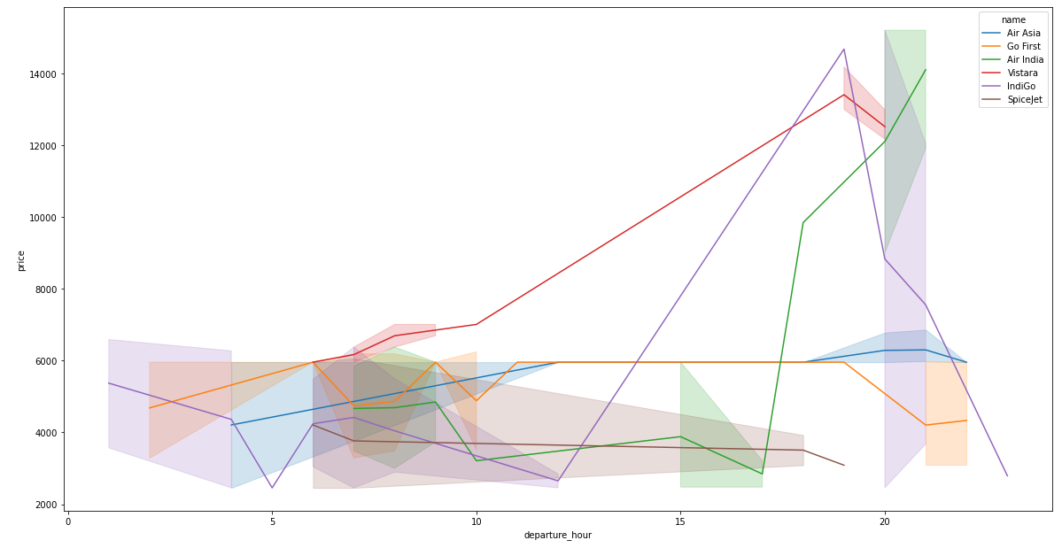
Exploratory Data Analysis performed on the dataset
Analysis Graph for Flight fare as per the morning and different time flights

Slide 12
Exploratory Data Analysis performed on the dataset
Removing Outliers: We replaced the outliers using IQR method. To increase the dataset quality. We confirmed the removal of outliers by plotting BoxPlot for the dataset
Code Logic Snippet:
IQR = df[col].quantile(0.75)-df[col].quantile(0.25)
Barmax = df[col].quantile(0.75) + 1.5*IQR
Barmin = df[col].quantile(0.25) - 1.5*IQR
df.loc[df[col]>Barmax,col] = Barmax
df.loc[df[col]<Barmin,col] = Barmin

Slide 13
Scaling the data
We Scaled the data using MinMaxScaler methodology
Code Logic Snippet
scaler = preprocessing.MinMaxScaler()
minmax_df = scaler.fit_transform(fin_df)
final_df = pd.DataFrame(minmax_df, columns = fin_df.columns)

Slide 14
Removing Skewness
We tried different methods to remove skewness -> Log method, Sqrt method, Power Method,
Power Method removed the skewness perfectly.
Code Snippet:
fin_df_new=power_transform(final_df)
fin_df_new = pd.DataFrame(fin_df_new,columns=final_df.columns)

Slide 15
Train Test Split
We split the data into training and testing categories with 7:3 ratio.
We used inbuilt function in the model_selection library of python
Code snippet:
x_train,x_test,y_train,y_test = train_test_split(x,y,test_size=.30,random_state=5)

Slide 16
Model training
We used different Models and compared the accuracy of the models:
Linear Regression
Decision Tree
Lasso
Ridge
Random Forest
ElasticNet

Slide 17
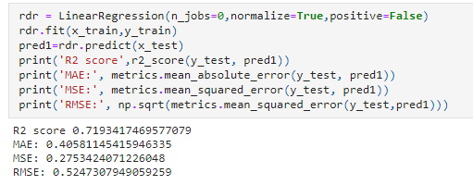
Model Training
After Cross Validation the best fit model is Linear Regression Model with R2 score of 0.71

Slide 18
Thank you

